Slide 1
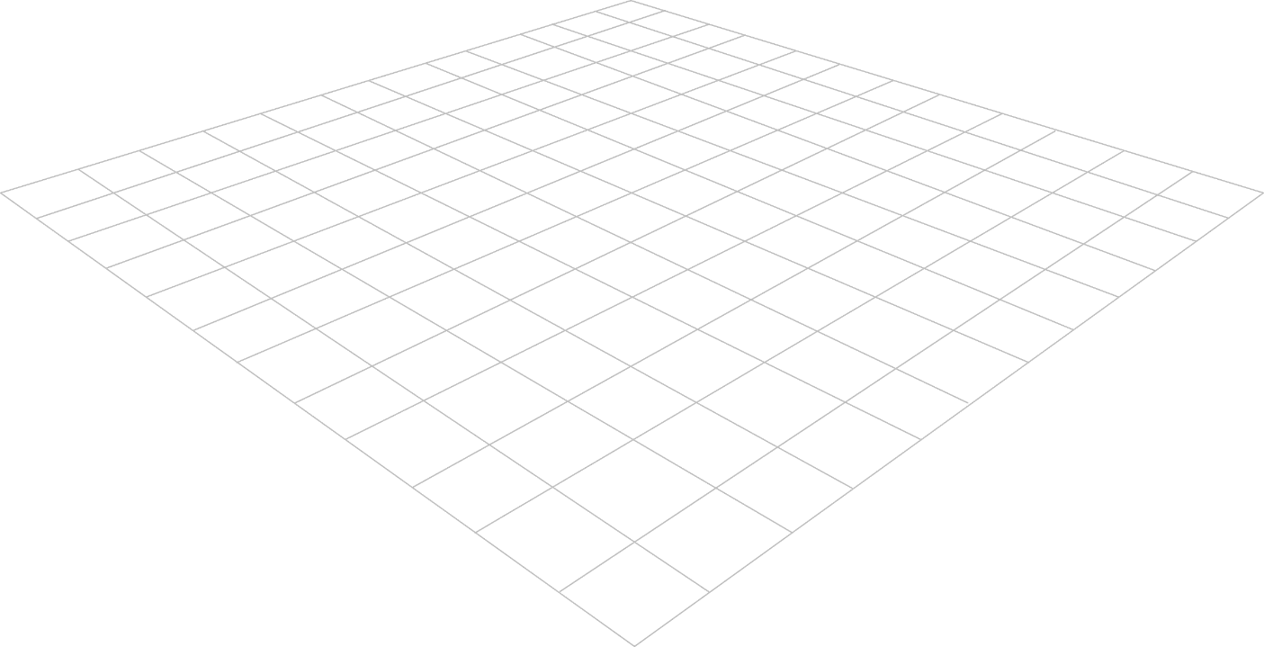
Measurement of Growth and Development
Part 1 : Physical Growth
Third Stage
Dr. Moustafa Alshammari
Pediatric lab

Slide 2
Anthropometric measurements
Anthropometric measurements are noninvasive quantitative measurements of the body. Essential parameter of nutritional status, is the measurement of height or length, weight, head circumference, chest circumference proportions, skinfold thickness, and arm circumference in young children. Height and head circumference reflect past nutrition, whereas weight, skinfold thickness, and arm circumference reflect present nutritional status, especially of protein and fat reserves.
(continued)

Slide 3
Growth Measurements
Measurement of physical growth in children is a key element in evaluating their health status. Physical growth parameters include weight, height (length), skinfold thickness, arm circumference, and head circumference. Values for these growth parameters are plotted on percentile charts, and the child’s measurements in percentiles are compared with those of the general population.
(continued)

Slide 4
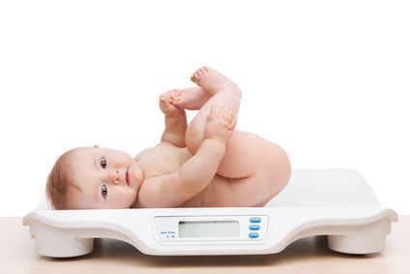
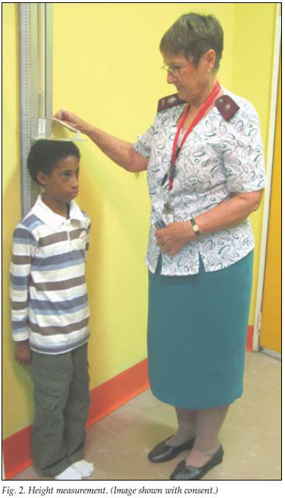
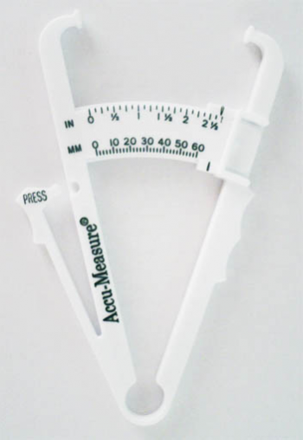
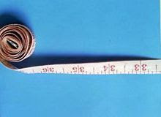
Equipment
Weight scale
Stadiometer
Skinfold calipers
Non-stretchable tape measure
Infantometer to measure the recumbent length

Slide 5
Technique
Growth Charts
Length
Height
Weight
Skinfold Thickness and Arm Circumference
Head Circumference
Chest circumference:
Body Mass Index

Slide 6
Growth Charts
Growth charts use a series of percentile curves to demonstrate the distribution of body measurements in children.
Notes:
Plot on Percentile Charts: You plot these measurements on percentile charts, which are graphs that display a range of values from the lowest (0th percentile) to the highest (100th percentile). Each percentile line represents a specific percentage of the population. For example, the 50th percentile represents the median or middle value for the general population.
Comparison: By plotting a child's measurements on these charts, you can see where their measurements fall in relation to the general population. For instance, if a child's height measurement is on the 75th percentile line, it means that their height is greater than or equal to 75% of children in the reference population.
Interpretation: The interpretation of these percentile measurements depends on the specific parameter being assessed. For example, if a child consistently falls below the 5th percentile for weight, it might indicate underweight or slow growth, while measurements consistently above the 95th percentile might indicate overweight or rapid growth. However, it's essential to consider various factors, including genetics and individual growth patterns, when interpreting percentile data.

Slide 7
Growth Charts
Children whose growth may be questionable include:
Children whose height and weight percentiles are widely disparate (e.g., height in the 10th percentile and weight in the 90thercentile, especially with above-average skinfold thickness)
Children who fail to follow the expected growth velocity in height and weight, especially during the rapid growth periods of infancy and adolescence

Slide 8
Growth Charts
Children who show a sudden increase (except during puberty), decrease, or no change in a previously steady growth pattern
Because growth is a continuous but uneven process, the most reliable evaluation lies in comparing growth measurements over time. It is important to remember that normal growth patterns vary among children the same age

Slide 9
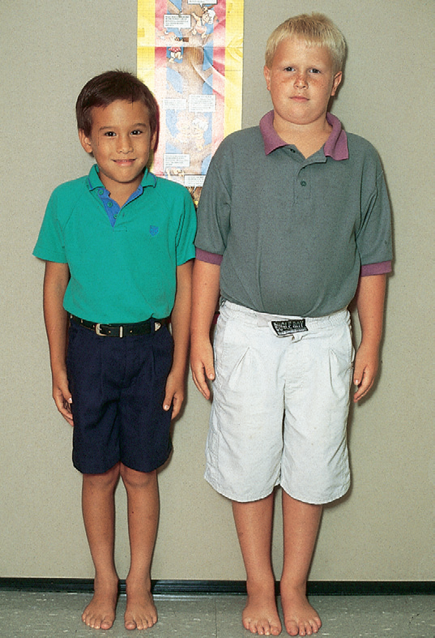
These children of identical age (8 years) are markedly different in size. Child on left, of Asian descent, is at 5th percentile for height and weight. Child on right is above 95th percentile for height and weight. However, both children demonstrate normal growth patterns.

Slide 10
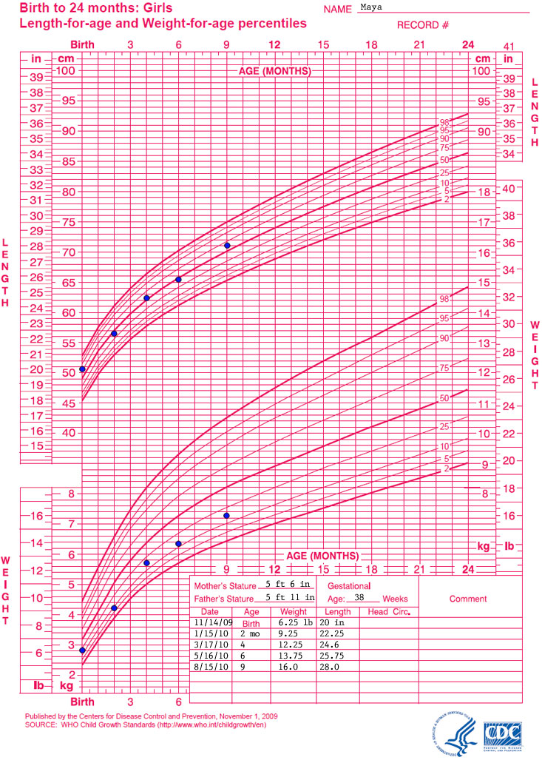
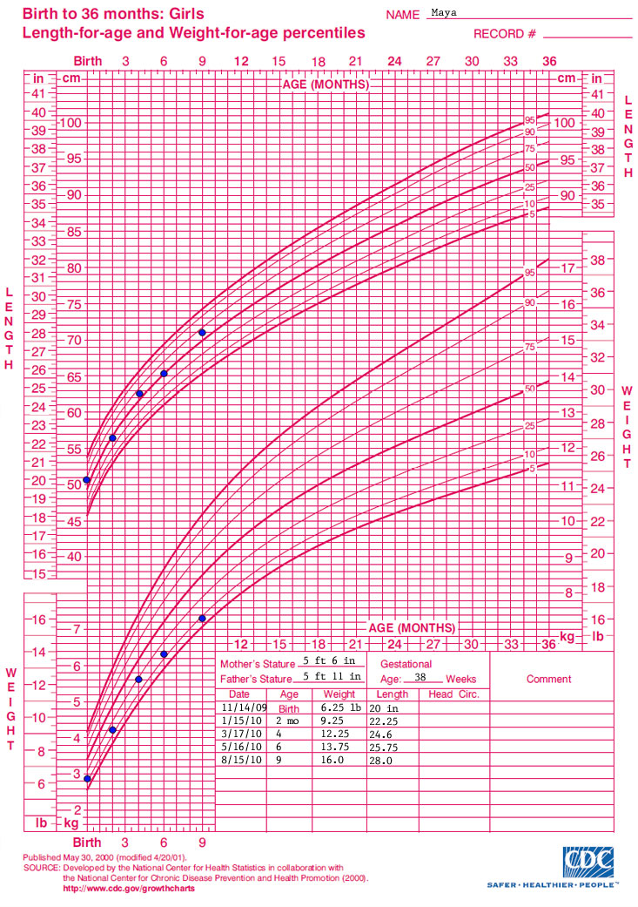

Slide 11
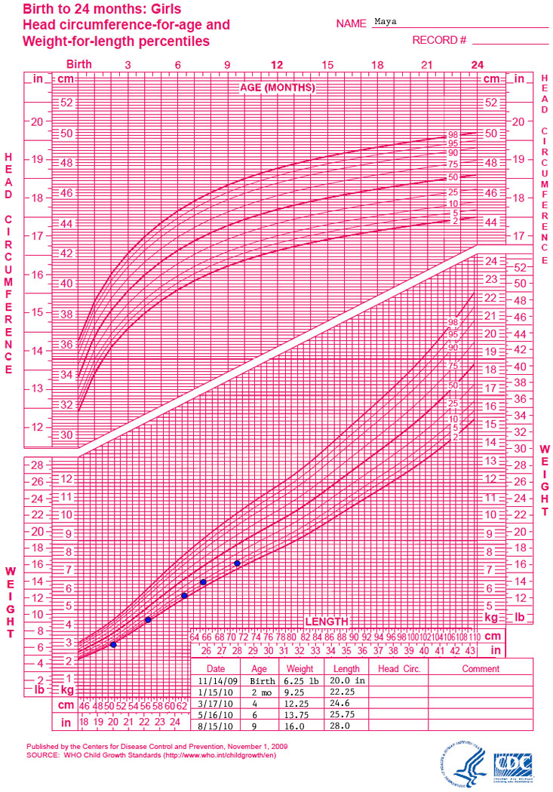
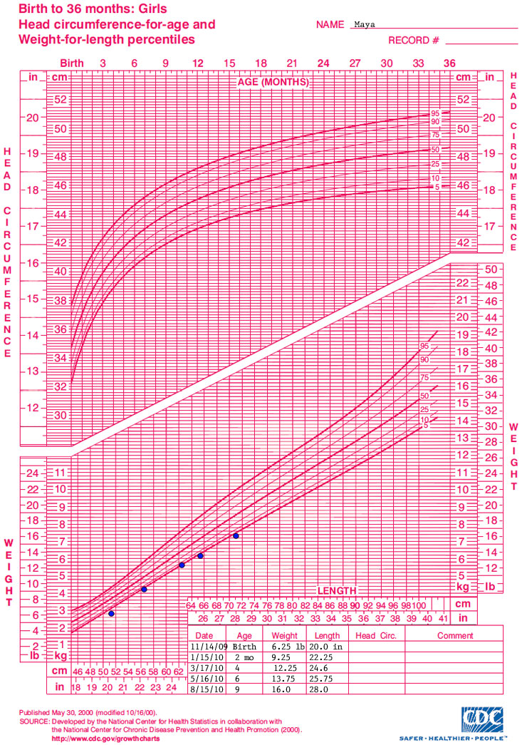

Slide 12
Length
The term length refers to measurements taken when children are supine
Length in infants are measured by lying in supine position on tray or board.
Hold the infant’s head in midline and extend the hips and knees flat on a paper-covered table, then Points are marked at the top of the head and the heels of the feet
Birth – 6 months: Monthly gain—2.5 cm (1 inch)
6-12 month: Monthly gain—1. 5 cm (0.5 inch)

Slide 13
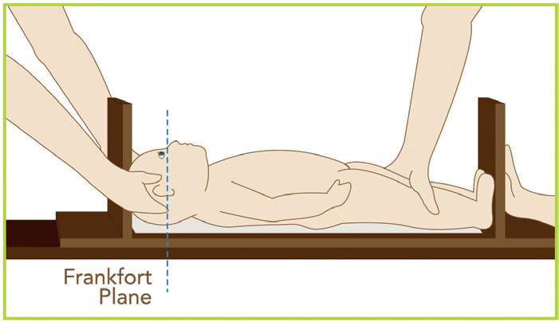
Measurement of Length
Newborn =48 to 53 cm (18.9 to 20.9 inches).
Infant =75 cm (30 inches).

Slide 14
Height
Height (or stature) refers to the measurement taken when a child is standing upright.
Measure height by having the child, with shoes removed, stand as tall and straight as possible, with the head in midline and the line of vision parallel to the ceiling and floor.

Slide 15
Height
Be certain the child’s back is to the wall or other vertical flat surface, with the heels, buttocks, and back of the shoulders touching the wall.
Check for and correct bending of the knees, slumping of the shoulders, or raising of the heels.
Normally, height is less if measured in the afternoon than in the morning. The time of day should be recorded when measurements are . For children in whom there are concerns about growth, serial measurements should be taken at the same time of day to establish an accurate growth velocity.

Slide 16
Height
For the most accurate measurement, use a wall-mounted unit (stadiometer). The movable measuring rod of platform scales is accurate only if it remains parallel to the floor and rests securely on the topmost part of the head.
To improvise a flat surface for measuring length, attach a paper or metal tape or yardstick to the wall, position the child adjacent to the tape, and place a three-dimensional object, such as a thick book or box, on top of the head.
Rest the side of the object firmly against the wall to form a right angle. Measure length or stature to the nearest 1 mm or 1/8 inch.

Slide 17
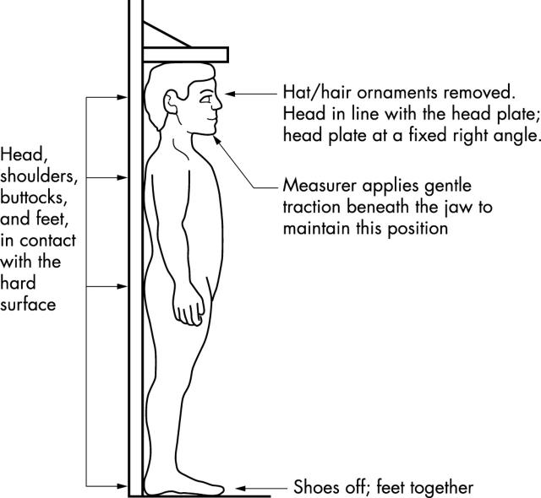
Measurement of height

Slide 18
Weight
At birth, weight 2700 to 4000 kg (6–9 pounds).
First, balance the scale.
Remove the infant’s diaper and clothing.
Depending on age, put the child is either supine or sitting.

Slide 19
Weight
When precise measurements are necessary, two nurses should take the weight independently; if there is a discrepancy, take a third reading.
Take measurements in a comfortably warm room.
When birth–to–36 months growth charts are used, children should be weighed nude.
Older children are usually weighed while wearing their underpants or a light gown.

Slide 20
Weight
Protect the infant from an accidental fall by placing a hand over the infant without direct contact.
At birth, weight is more variable than height and is, to a greater extent, a reflection of the intrauterine environment.

Slide 21
Weight
Normally, neonates lose about 10% of their birth weight by 3 to 4 days of age because of loss of extracellular fluid and meconium, as well as limited food intake, especially in breastfed infants.
In general, the birth weight doubles by 4 to 7 months of age, triples by the end of the first year. Quadruples by the age of 2 to 2.5 years.

Slide 22
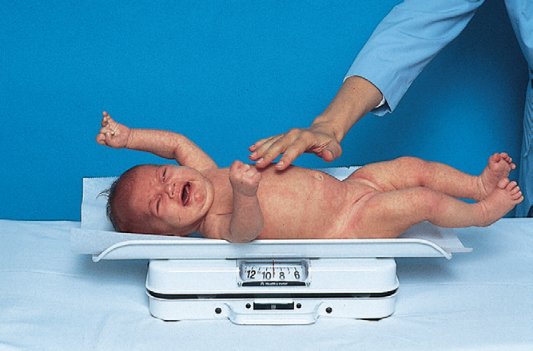
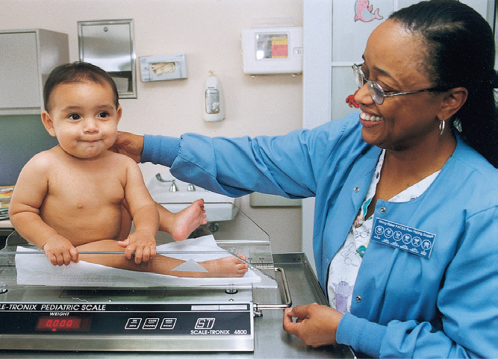
Weight
Infant on scale.
Toddler on scale. Note presence of nurse to prevent falls.

Slide 23
Weight progression (1-12 month)
First 4 month = 750 gm /month
2nd 4 months = 500 gm /month
3rd 4 months = 250 gm/month
Progression in year: Weight (kg/years) = (age + 4) ×2.
Ex: 2-year-old will weigh: (2 + 4) ×2 = 12kg.

Slide 24
Skinfold Thickness
Measures of relative weight and stature cannot distinguish between adipose (fat) tissue and muscle. One convenient measure of body fat is skinfold thickness,
Measure skinfold thickness with special calipers, such as the Lange calipers. The most common sites for measuring skinfold thickness are the triceps (most practical for routine clinical use), subscapula, suprailiac, abdomen, and upper thigh.

Slide 25
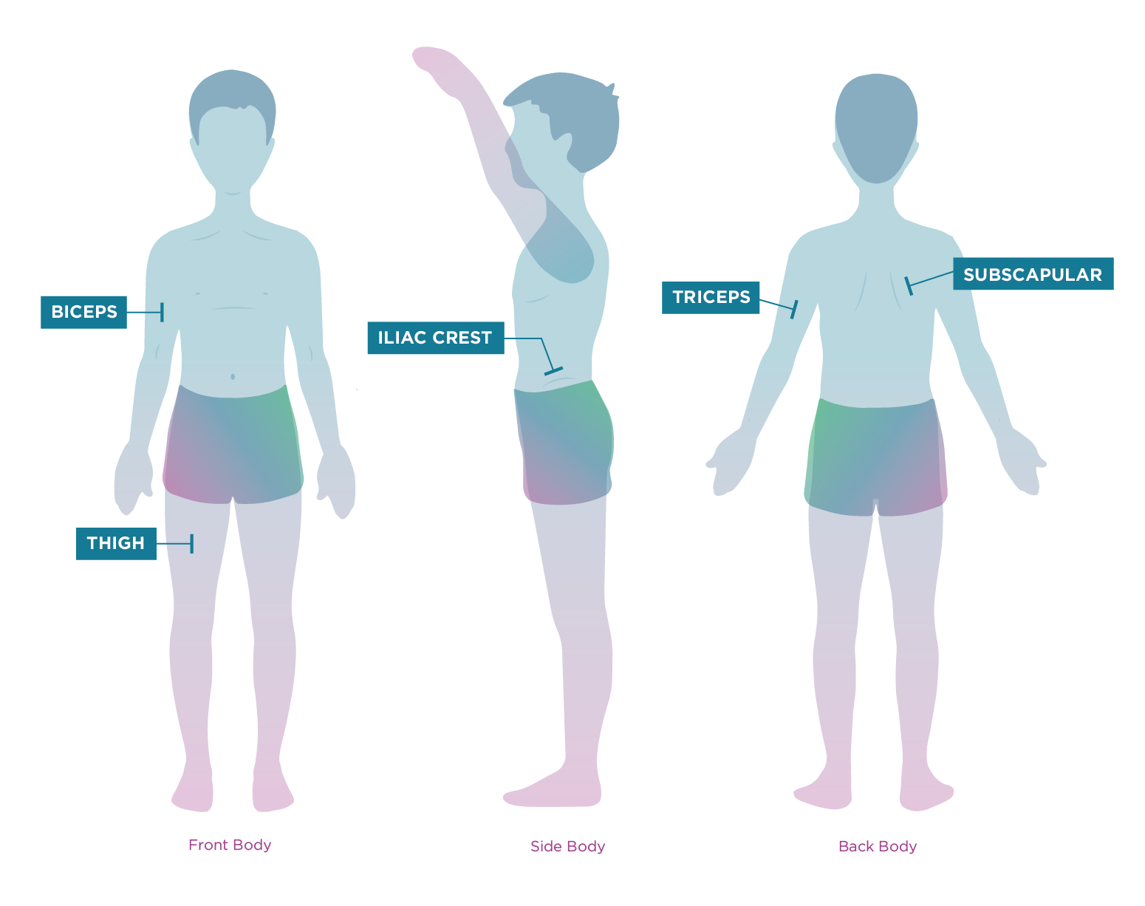

Slide 26
Skinfold Thickness
For greatest reliability, follow the exact procedure for measurement, and record the average of at least two measurements of one site.

Slide 27
Head Circumference
Head circumference is a critical indicator of brain growth in infants and toddlers.
Full-term infants, average head circumference is between 33 and 35.5 cm (13 and 14 inches).
Measure head circumference in children up to 36 months of age
The rate of increase in head circumference slows somewhat by the end of infancy, and head circumference is usually equal to chest circumference by 1 to 2 years of age.

Slide 28
Head Circumference
The usual total increase in head circumference during the second year is 2.5 cm (1 inch). Then the rate of increase slows until at age 5 years, the increase is less than 1.25 cm (0.5 inch) per year.
The head’s largest circumference is measured by placing the tape over the lower forehead, above the pinna of the ears, and over the occipital prominence.

Slide 29
Head Circumference
Head circumference is usually about 2 to 3 cm (≈1 inch) greater than chest circumference.
Because of the molding of the head during delivery, these measurements may initially appear equal. microcephaly or premature closure of the sutures (craniosynostosis) is a possibility. The head is more than 4 cm (1.6 inches) larger than the chest and this remains constant or increases over several days, then hydrocephalus must be considered.

Slide 30
Head Circumference
During the first 6 months, head circumference increases approximately 1.5 cm (0.6 inch) per month, but the rate of growth declines to only 0.5 cm (0.2 inch) monthly during the second 6 months.
Closure of the cranial sutures occurs, with the posterior fontanel fusing by 6 to 8 weeks of age and the anterior fontanel closing by 12 to 18 months of age (average, 14 months).

Slide 31
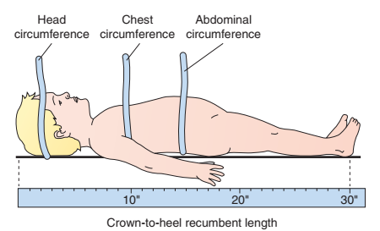
Head Circumference
Measurement of head, chest, and abdominal circumference and crown-to-heel (recumbent) length.

Slide 32
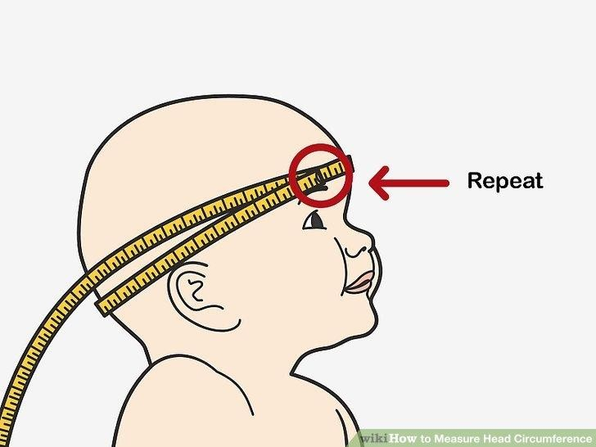
Head Circumference
Measurement of head,
H.C (Birth – 6 months): Monthly gain—1.5 cm
H.C (6-12 month): Monthly gain—0. 25 cm

Slide 33
Body Mass Index
BMI is also a part of assessing growth and can be tracked over time.
BMI is the number calculated from the child’s weight and height that correlates to the percentage of body fat. The higher the child’s BMI, the higher the percentage of body fat.

Slide 34
Parameters
Underweight: BMI of less than 18.5
Normal weight: BMI of 18.5 to 24.9
Overweight: BMI of 25 to 29.9
Obesity: BMI of 30 or greater

Slide 35
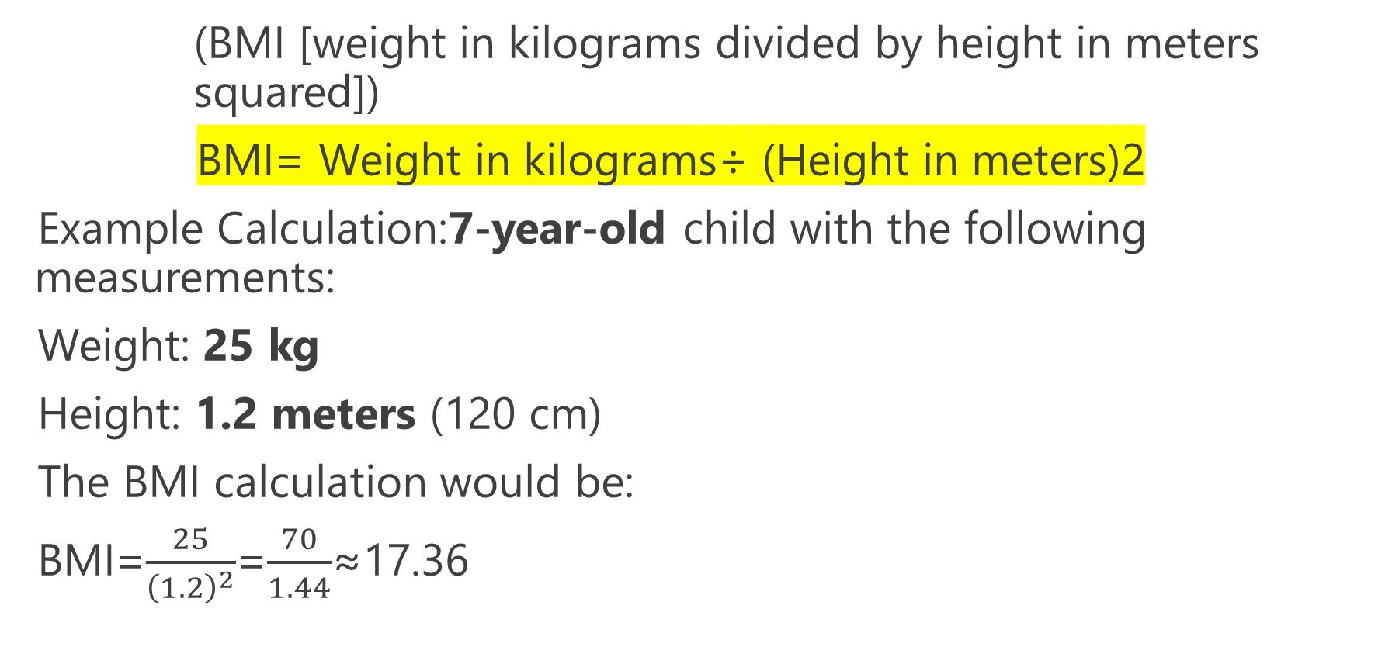
Body Mass Index Formula
(BMI [weight in kilograms divided by height in meters squared])
BMI= Weight in kilograms÷ (Height in meters)2
Example Calculation:7-year-old child with the following measurements:
Weight: 25 kg
Height: 1.2 meters (120 cm)
The BMI calculation would be:
BMI=$\frac{25}{{\left(1.2\right)}^{2}}$=$\frac{70}{1.44}$≈17.36

Slide 36
Thank you

